Slide 1
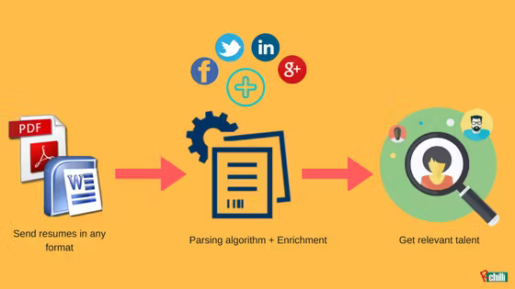

Resume Parsing
and Scoring System
Using Natural Language Processing to Extract Key Resume Details
By: Moses Mugambi

Slide 2
Problem Statement
Recruiters often spend hours manually screening resumes, leading to inefficiencies, inconsistencies, and potential bias in hiring. Traditional methods struggle to process diverse resume formats and extract relevant information accurately.
With the rise of AI and automation, resume parsing has become essential for streamlining recruitment, improving candidate selection, and enhancing HR efficiency.
Project Goal: Develop robust resume parser system that can accurately extract key details like skills and experience, and score/rank CVs making hiring faster and more efficient.

Slide 3
Project Objectives
Develop a Named Entity Recognition model to extract key resume details such as Candidates Information (Contacts, Educational Background, Work Experience, Job Role/Title), Skills.
Score and Rank Resumes based on Job description.
Batch resume handling.
Deploy a demonstration web application using Streamlit.

Slide 4
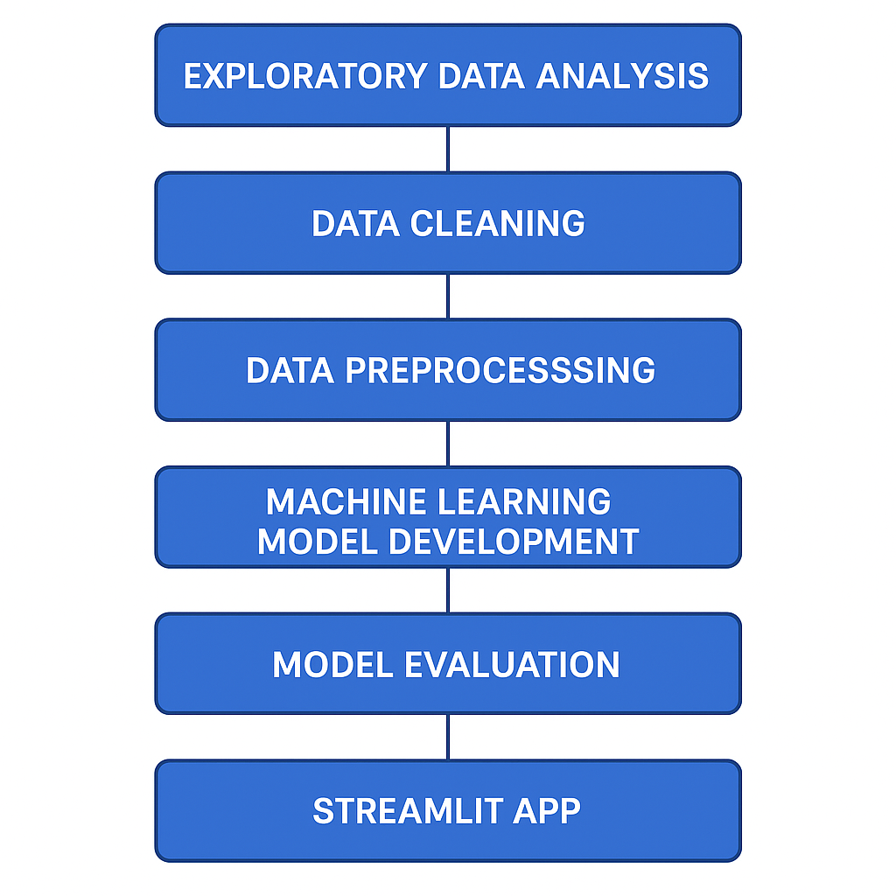
1. Exploratory Data Analysis.
2. Data Cleaning.
3. Data Preprocessing.
4. Machine Learning Model Development.
5. Model Evaluation
6. Streamlit App.
Project Overview

Slide 5
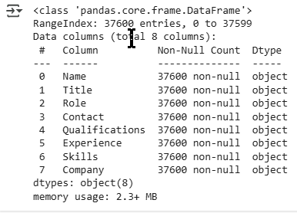
Data Sourcing
The original jobs dataset was sourced from Kaggle
CSV file with Job Roles and extracted texts (1.6 million entries and 23 columns)
Unnecessary columns were dropped.

Slide 6

EDA

Slide 7
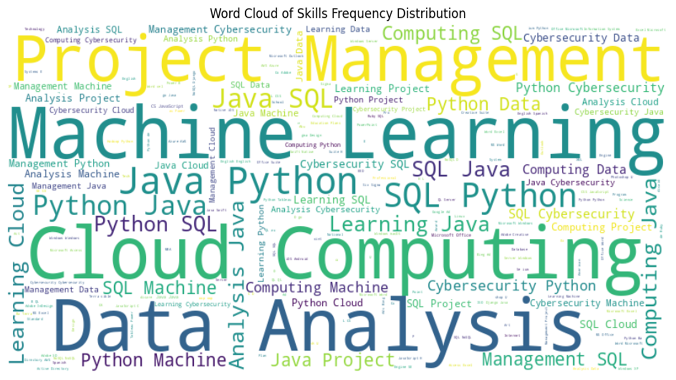
EDA

Slide 8
Model Selection
A DistilBERT model was selected for Named Entity Recognition.
Lightweight & Efficient. DistilBERT is 40% smaller and 60% faster than BERT, making it ideal for real-time parsing systems.
Good Performance. Retains over 95% of BERT’s accuracy, ensuring robust Named Entity Recognition (NER).
Pretrained on Rich Text Corpora meaning it can understand contextual meaning in resumes effectively.
Easily adaptable for classification, entity extraction, and similarity tasks.
Suitable for deployment in web apps like Streamlit for instant resume analysis.

Slide 9
Data Preprocessing Steps
Raw Text : Start with the input text.
Tokenization : Split the text into tokens.
Token BIO tagging
Numerical Encoding : Convert tokens to integers.
Embedding Conversion : Map integers to dense vectors.

Slide 10
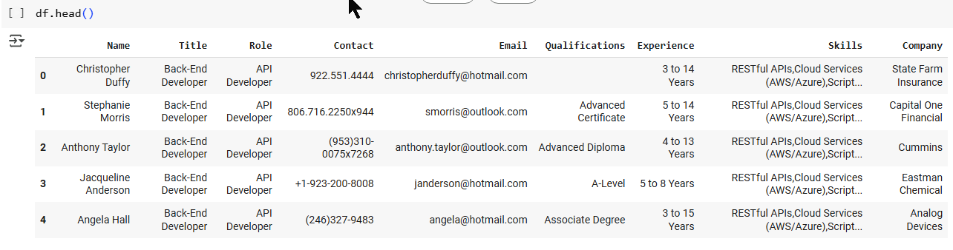
Data Preprocessing : Text tokenization
Tokenized Dataset Example:
{'Name': 'Stephanie Morris', 'Title': 'Back-End Developer', 'Role': 'API Developer', 'Contact': '806.716.2250x944', 'Email': 'smorris@outlook.com', 'Qualifications': 'Advanced Certificate', 'Experience': '5 to 14 Years', 'Skills': 'RESTful APIs, Cloud Services (AWS/Azure), Scripting (Python/Bash), Debugging, Version Control (Git), API design and development , 'Company': 'Capital One Financial'}

Slide 11
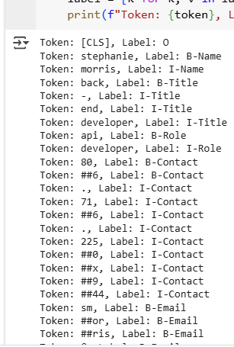
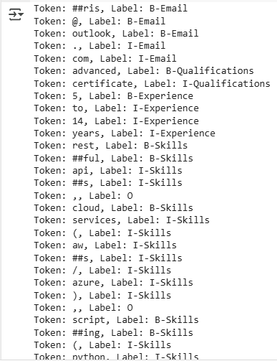
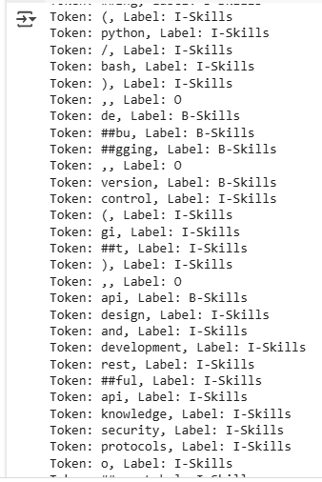
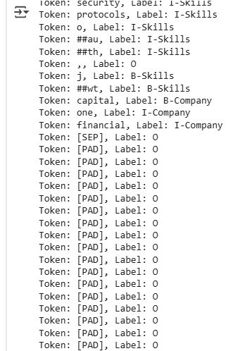
Data Preprocessing : (Token BIO Tagging)
B- denotes the beginning of an entity, I- denotes inside an entity, and O denotes no entity.

Slide 12
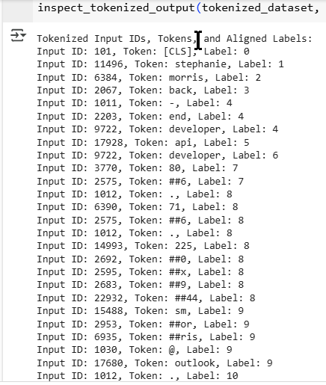
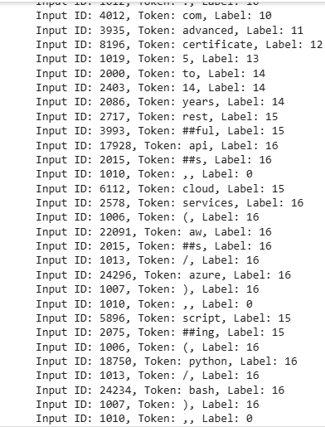
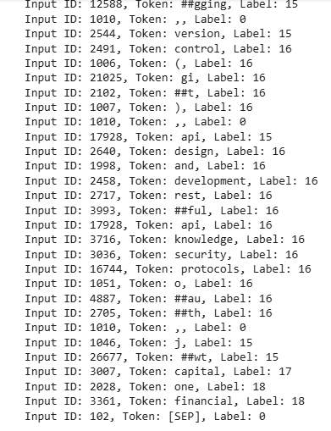
Data Preprocessing : (Numerical Labelling)
Numerical labels are then converted to embeddings (vectors) using a vector map in the embedding layer

Slide 13
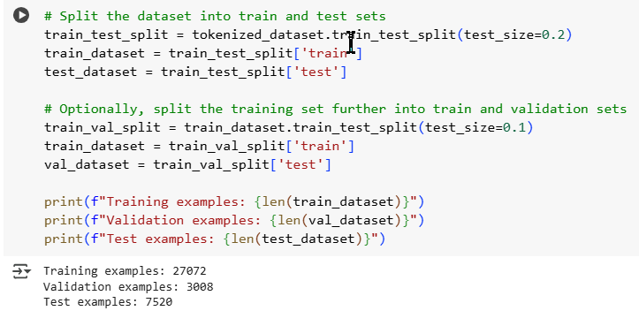
Train - Test Split
Only a small fraction of the dataset was used due to computational limitations (37600) entries

Slide 14
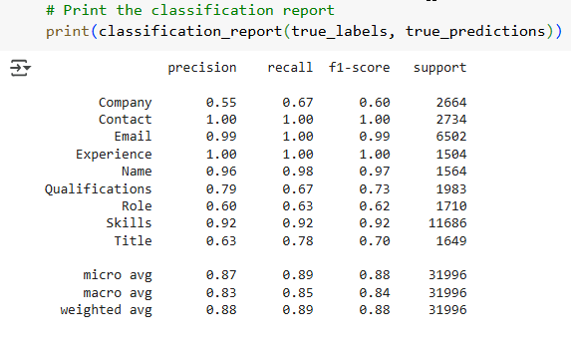
Modelling Results and Evaluation

Slide 15
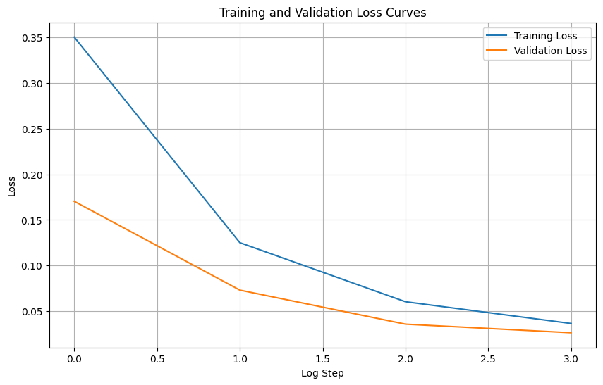
Overfitting Analysis (Loss Curves)

Slide 16
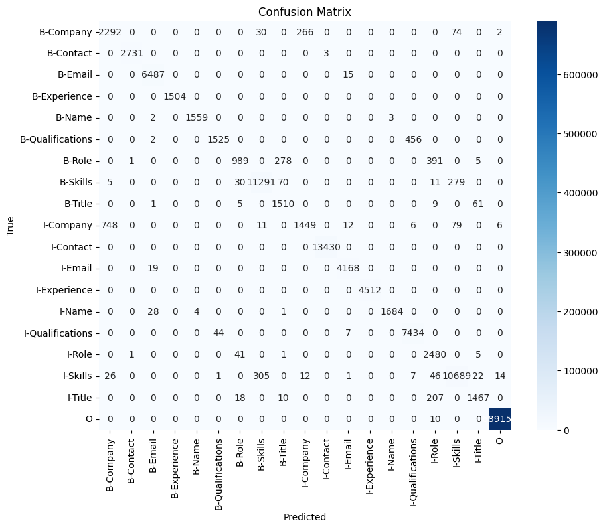
Confussion Matrix

Slide 17
Streamlit Web Application

Slide 18
Challenges
Unable to train on entire dataset due to computational and time limitations.
Model overfitting during training.
Faced difficulties in streamlit model app deployment

Slide 19
Future Improvements
Use a large and diverse manually annotated dataset.
Domain-specific fine-tuning for improved accuracy.
Support for multilingual resumes.
Integration with job boards or ATS.
Highly interactive dashboard for recruiters to manage parsed resumes.

Slide 20
Conclusion
Automated resume parsing system using NLP to extract entities and score resumes.
Streamlit interface for ease of use.

